Slide 1

CS2009 Design and Analysis of Algorithms
Divide and conquer + Merge sort

Slide 2
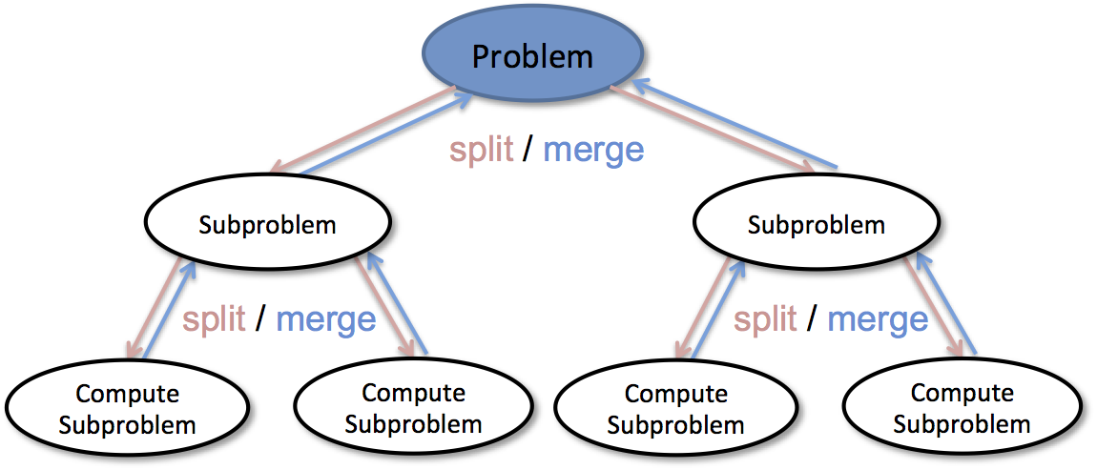
Divide & Conquer Algorithms
A divide-and-conquer algorithm works by recursively breaking down a problem into two or more sub-problems of the same or related type, until these become simple enough to be solved directly.

Slide 3
Merge Sort : Divide & Conquer Algorithm
Divide and Conquer strategy is applicable in huge number of computational problems as this strategy takes less amount of time.
Merge sort is an example of divide and conquer strategy
Merge sort algorithm is used to sort numbers in “nlogn” time which is better than many sorting algorithms that usually take “n^2” time

Slide 4
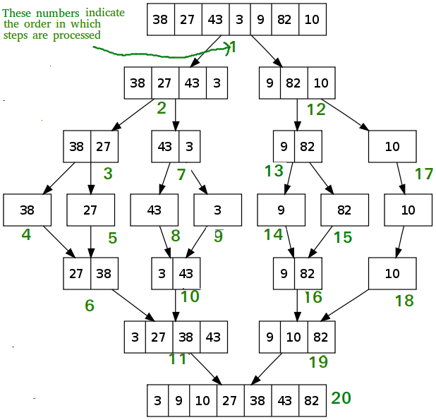
Merge Sort : Divide & Conquer Algorithm
It divides elements until single element left and then merge them in sorting order.

Slide 5
GUESS THE OUTPUT OF THIS RECURSION CODE !
void A (int n)
{
If (n>0)
{
A(n-1);
Printf(“%d”,n);
}
}
void main()
{
int x=3;
A(x);
}

Slide 6
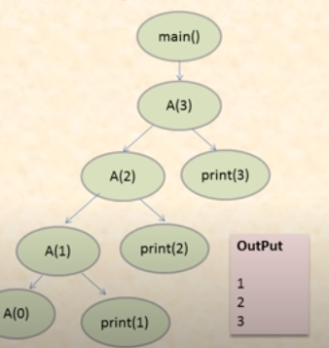
void A (int n)
{
If (n>0)
{
A(n-1);
Printf(“%d”,n);
}
}
void main()
{
int x=3;
A(x);
}

Slide 7
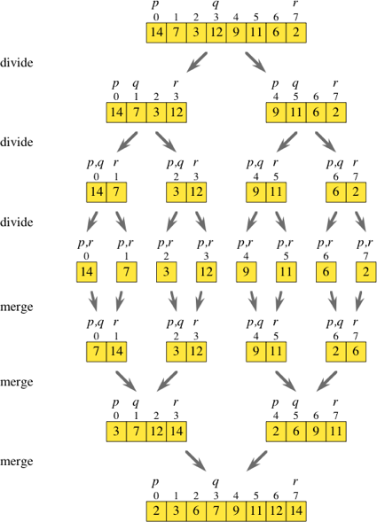
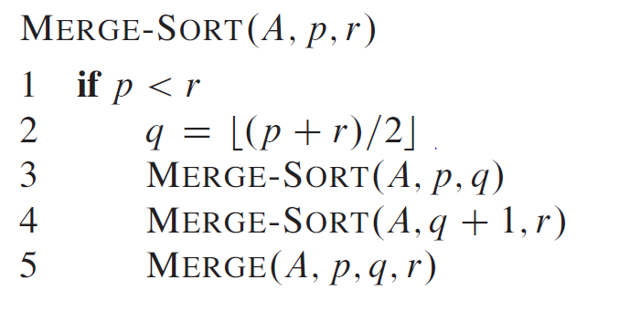
Merge Sort : Divide & Conquer Algorithm

Slide 8
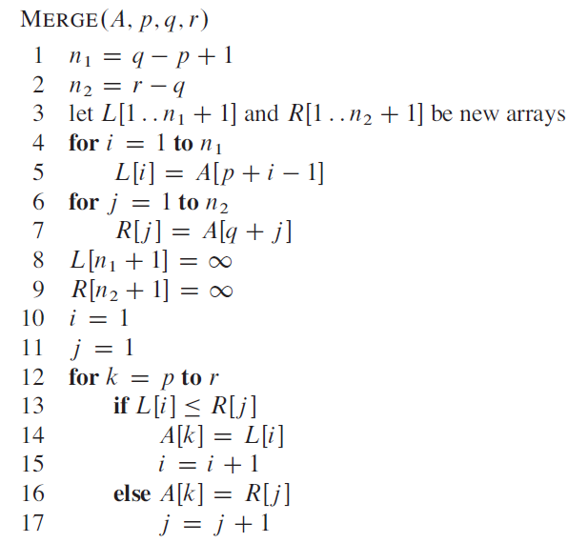
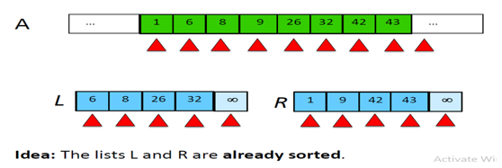
Merge Sort : Divide & Conquer Algorithm

Slide 9
Merge Sort : Divide & Conquer Algorithm
In Merge Code in previous slide, line 8 and 9 shows that last element in L[] and R[] subarrays
is “sentinel” which is infinity. The use of sentinels in merge sort prevents us from needing to
check to see if we have reached the end of either of the arrays being sorted. Infinity is the largest
element and at the end of merging process, pointers at both subarrays(L and R) will be pointing to
infinity which indicates the end.
8. L[n1+1] = infinity
This line 8 shows that last element of left subarray L (having length n1+1) is equal to the infinity
9. R[n2+1] = infinity
This line 9 shows that last element of right subarray R (having length n2+1) is equal to infinity

Slide 10
Merge Sort : Divide & Conquer Algorithm
Sequence will always be this as shown by green numbers :

Slide 11
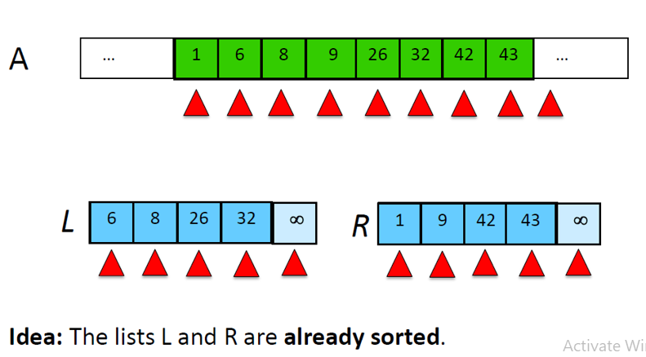
Merge Sort : Divide & Conquer Algorithm
How it is merging elements actually:
First element of both sub arrays(L and R) are compared which are 6 and 1. The one which is smaller will be moved to array A and pointer of that sub-array will be incremented by 1. As 1<6 so 1 will be moved to array A and pointer will be incremented to 9 in sub array R. As 6 < 9 so 6 will be moved to array A and pointer of array L will be incremented by one to compare 8 with 9. This goes on till all get sorted.

Slide 12
Merge Sort : Divide & Conquer Algorithm
Must watch this video to understand MergeSort working
https://drive.google.com/file/d/1Jl3k2fqAMQmNgPfnOrWARRxglWXPpDyl/view?usp=sharing
Now lets talk about loop invariant of MergeSort . . .

Slide 13
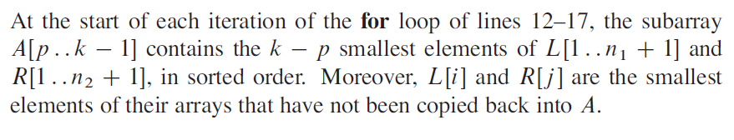
Merge Sort : Divide & Conquer Algorithm
Proof of correctness:
Loop Invariant:

Slide 14
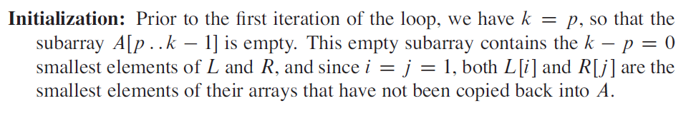
Merge Sort : Divide & Conquer Algorithm
Proof of correctness:

Slide 15
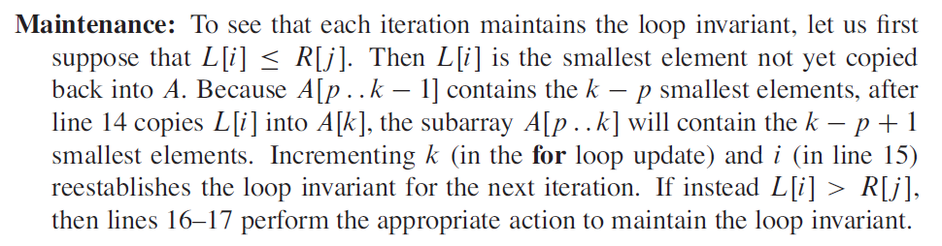
Merge Sort : Divide & Conquer Algorithm
Proof of correctness:

Slide 16
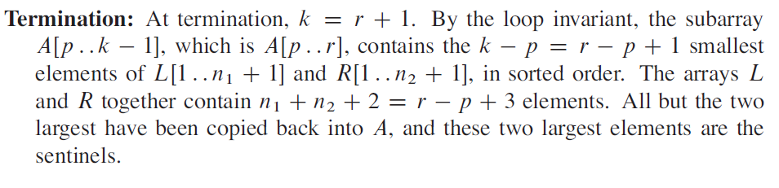
Merge Sort : Divide & Conquer Algorithm
Proof of correctness:

Slide 17
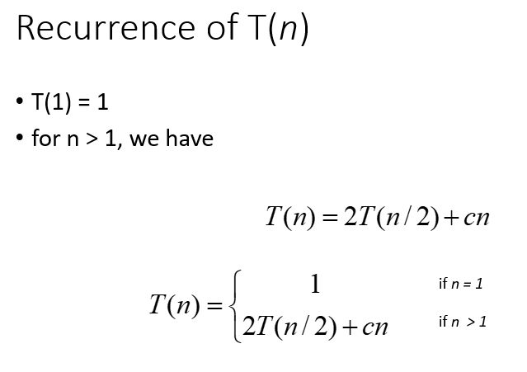
Merge Sort : Divide & Conquer Algorithm
Assume T(n) be the running time of merge sort for sorting an array of “n” elements then:

